Slide 1
REINVENT: A Low-Cost, Virtual Reality Brain-Computer Interface for Severe Stroke Upper Limb Motor Recovery
IEEE Virtual Reality 2017

Slide 2
Introduction
1. Stroke is one of the leading causes of adult disability worldwide, and up to 2/3 of stroke survivors never fully recover.
2. Emerging research has examined ways to facilitate activation of the damaged motor cortex.
(1) The action observation network (AON).
(2) Neurofeedback from brain-computer interfaces (BCIs).
3. The AON consists of motor-related regions in the brain that are active during both the performance of an action and simply during the observation of an action.
4. BCI-based neurofeedback is typically defined as sensory feedback of biological activity in the brain that is used to control a computerized device (e.g., movement of an object on a computer screen)

Slide 3
Introduction
5. Both AON-based therapies and BCIs typically produce only modest gains. One way to improve gains may be to combine approaches, and provide biologically-relevant action observation feedback in an immersive virtual reality BCI environment.
6. REINVENT pairs an individual’s own neural and muscular commands with augmented, but believable, embodied feedback of one’s own movements in virtual space.
7. REINVENT’s VR system will provide realistic, augmented visual feedback of the participant’s limb moving in virtual space, even if the patient is not moving in reality.

Slide 4
System Description
1. Hardware
(1) OpenBCI EEG/EMG device
(2) Nine Degrees of Freedom (9DOF) interial measurement units (IMUs)
(3) A computer
(4) Head-Mounted Display (HMD)
2. Software
(1) A .NET 4.5 application receives data from OpenBCI and IMU systems
(2) REINVENT VR is implemented in Unity 5.4
(a) In the case of IMU input, the user’s virtual arm is directly animated.
(b) In EEG（脑电信号） and EMG（肌电信号） input, the virtual arm’s position is incremented towards the goal position, or decays towards the rest position, based on an instantaneous comparison of the activity level to a resting baseline.

Slide 5
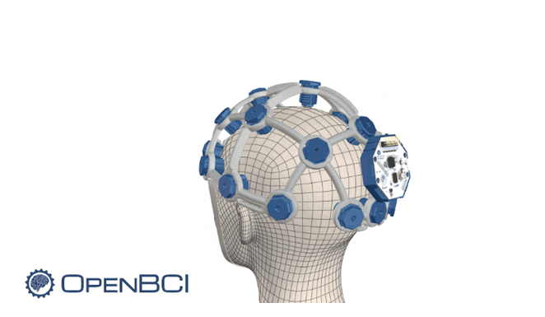
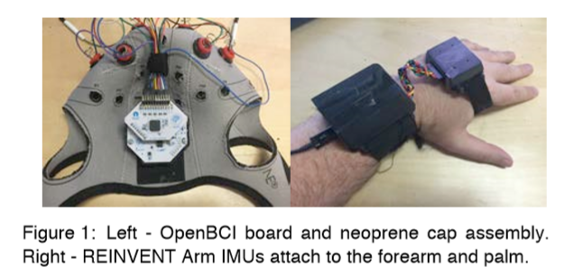

Slide 6
Methods
1. Participants:
(1) 12 individuals (11 female/1 male, aged: M=83±10.5).
2. Inclusion criteria:
(1) Healthy individuals.
(2) No previous experience with virtual reality.
3. Protocol:
(1) 1-hour experiment.
(2) Participants were asked to rest for a 30second baseline calculation of EEG and EMG signals.
(3) Participants were then asked to try to control their virtual arm in REINVENT and move it towards goal positions using either actual arm movements (IMUs), just muscle activity (EMG), or just brain activity (EEG; using motor imagery), for up to thirty trials of each.

Slide 7
Methods
4. Outcomes:
(1) Simulator Sickness Questionnaire.
(2) How interesting and enjoyable they found REINVENT (on a scale of 1 to 10, 1 being “not at all” and 10 being “extremely”).

Slide 8
Results
1. Participants reported little to no physical discomfort across all categories of the Simulator Sickness Questionnaire (total m:1.16±0.29)
2. Participants also rated REINVENT extremely interesting (m:9.67±0.62), extremely enjoyable (m:8.92±1.19), and all twelve were willing to try the device again.

Slide 9
Conclusion
1. We have described a novel low-cost, portable VR-based brain computer interface and demonstrated the feasibility and safety of using this device with older adults.

